Slide 1
Pivotal Cloud Platform Deep Dive
Part 2: Architecture and The Operator Experience
Pivotal CF Team

Slide 2


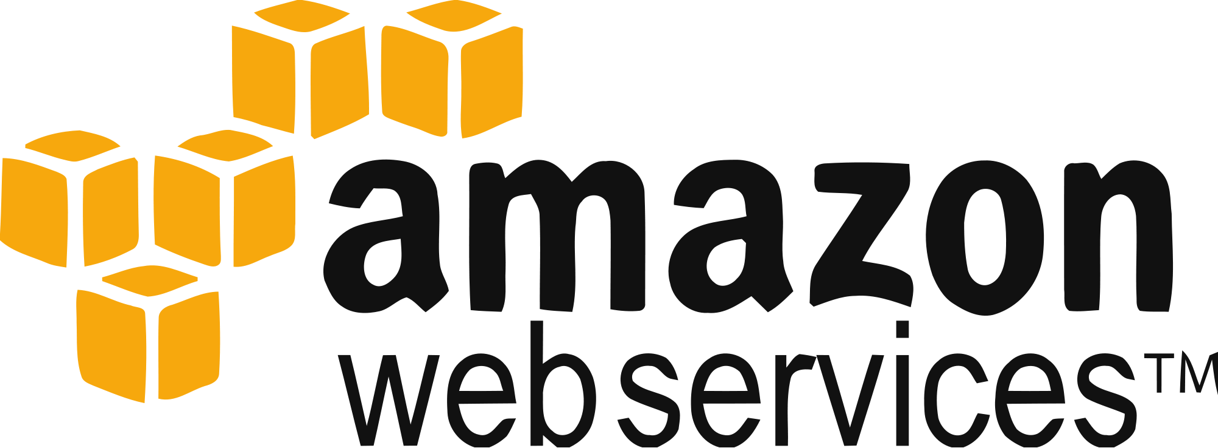
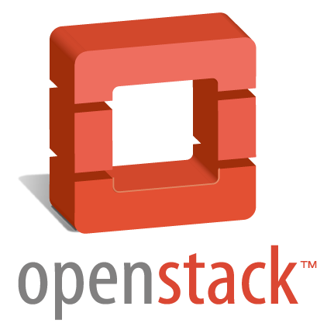
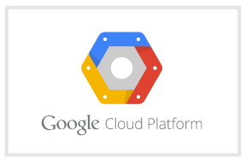

Cloud Foundry Architecture Stack
Router
Cloud Controller
UAA/Login Servers
Health Manager
Service Broker Node(s)
DEA Pool
Loggregator

Messaging (NATS)
BOSH Director
BOSH Agent
IaaS

Slide 3

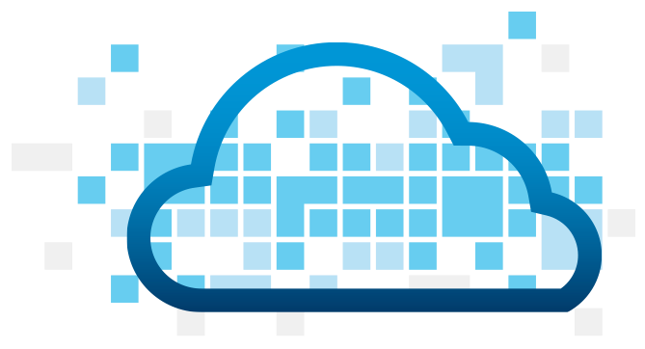
Pushing an application
Blobstore
DB
SC
push app
+ app MD
Cloud Controller
Service Broker
Node(s)
Router
Upload bits/metadata
Create/bind services
Stage app
Deploy app
DEA
DEA
DEA
+
=
DEA
Runtime

Slide 4
Application Staging
Blobstore
DB
Cloud Controller
Router
DEA
System
Buildpacks
Detect
Compile
Upload
Yes
No
+
=
Runtime
Runtime

Slide 5
Application containers and scaling
Blobstore
Cloud Controller
Messaging (NATS)
Access App
Router
DEA
DEA
DEA
Runtime

Slide 6
Service create and bind
DB
Service
credentials
CLI
create service (HTTP)
Cloud Controller
create service (HTTP)
Service
Broker
reserve resources
Data
Service
Router
bind service (HTTP)
bind service (HTTP)
obtain connection data
Runtime

Slide 7
Cloud Foundry Architecture Stack
Router
Cloud Controller
UAA/Login Servers
Health Manager
Service Broker Node(s)
DEA Pool
Loggregator

Messaging (NATS)
BOSH Director
BOSH Agent
IaaS

Slide 8
What’s on Pivotal CF for an operator?

Slide 9


Pivotal CF operations
Developer
Operator

Slide 10


Deploy to dev
Install runtime and container

Slide 11

Install runtime and container
Deploy to dev
Install services (db,
messaging, hadoop, …)

Slide 12

Install runtime and container
Deploy to dev
Install services (db,
messaging, hadoop, …)
Setup load-balancing, SSL termination and dynamic routing

Slide 13

Install runtime and container
Deploy to dev
Install services (db,
messaging, hadoop, …)
Setup load-balancing, SSL termination and dynamic routing
Setup / config High Availability

Slide 14

Install runtime and container
Deploy to dev
Install services (db,
messaging, hadoop, …)
Setup load-balancing, SSL termination and dynamic routing
Setup / config High Availability
Setup APM

Slide 15

Install runtime and container
Deploy to dev
Install services (db,
messaging, hadoop, …)
Setup load-balancing, SSL termination and dynamic routing
Setup / config High Availability
Setup APM
Setup log streaming

Slide 16




Install runtime and container
Deploy to dev
Install services (db,
messaging, hadoop, …)
Setup load-balancing, SSL termination and dynamic routing
Setup / config High Availability
App Deployed
Setup APM
Setup log streaming

Slide 17
Blue-green deployment
Restart server
Upgrade app
Install runtime and container
Deploy to Test
Create service
Change JDK
Deploy to dev
Redeploy
Install services (db,
messaging, hadoop, …)
Scale Platform
Scale up
Bind service
Update app
Setup load-balancing and dynamic routing
Deploy to QA
Update app server
Unbind service
Setup / config High Availability
Change route
Promote to production
Setup APM
Escale memory
Check logs
Setup log streaming
Scale down
Delete App

Slide 18

Blue-green deployment
Restart server
Upgrade app
Install runtime and container
Deploy to Test
Create service
Change JDK
Deploy to dev
Redeploy
Install services (db,
messaging, hadoop, …)
Scale Platform
Scale up
Bind service
Update app
Setup load-balancing and dynamic routing
Deploy to QA
Update app server
Unbind service
Setup / config High Availability
Change route
Promote to production
Setup APM
Escale memory
Check logs
Setup log streaming
Scale down
Delete App

Slide 19

The Pivotal CF way
Deploy to dev

Slide 20








The Pivotal CF way
Deploy to dev
Cloud
Controller
Health Manager
> cf push
NATS
(message bus)
App Deployed
Router
Router

Slide 21
The operator in the PaaS era
Developer
Operator

Slide 22


The operator in the PaaS era

Slide 23



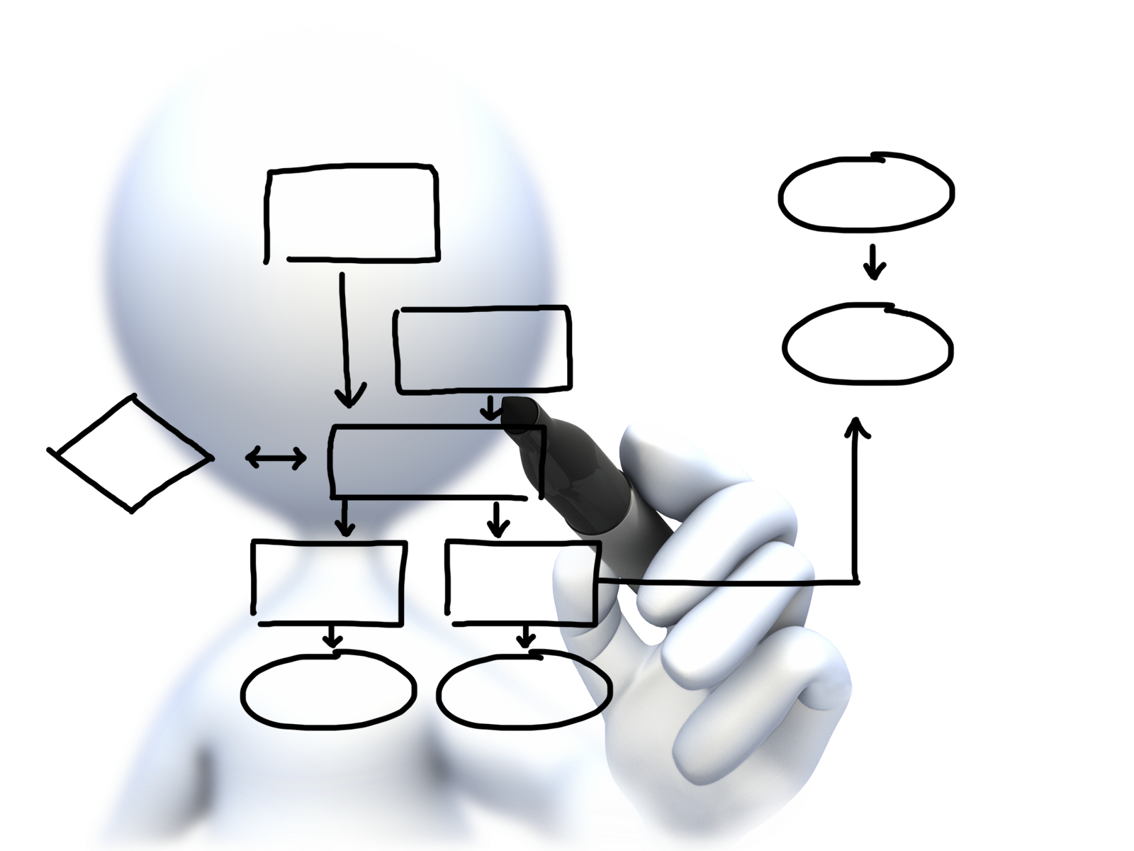


Plan capacity
Setup High Availability
Install the platform
Operator Concerns
Manage users
and quotas
Handle upgrades and updates
Monitor the platform

Slide 24









Install the platform
Setup High Availability
Pivotal CF
Install and manage services
Target multiple clouds
IaaS
Handle live upgrades and updates
Scale and
plan capacity

Slide 25


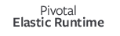

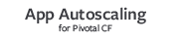







CloudBees Jenkins
Enterprise
Cassandra
for Pivotal CF
ElasticSearch
for Pivotal CF
Mobile Services
for Pivotal CF
BOSH Director
BOSH Agent
IaaS

Slide 26
Click to install
No downtime updates
Explore install logs
Click to scale the platform
CloudBees Jenkins
Enterprise
Built-in High Availability
Cassandra
for Pivotal CF
Built-in Platform Monitoring
ElasticSearch
for Pivotal CF
Mobile Services
for Pivotal CF
BOSH Director
BOSH Agent
Integrated services
IaaS

Slide 27
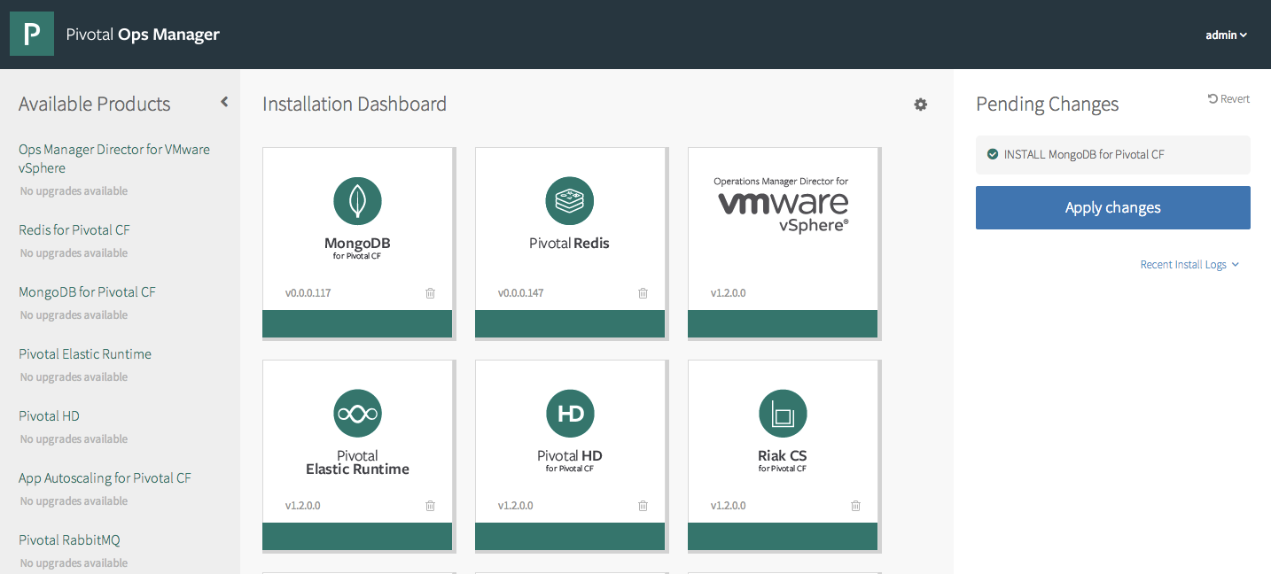

Demo

Slide 28
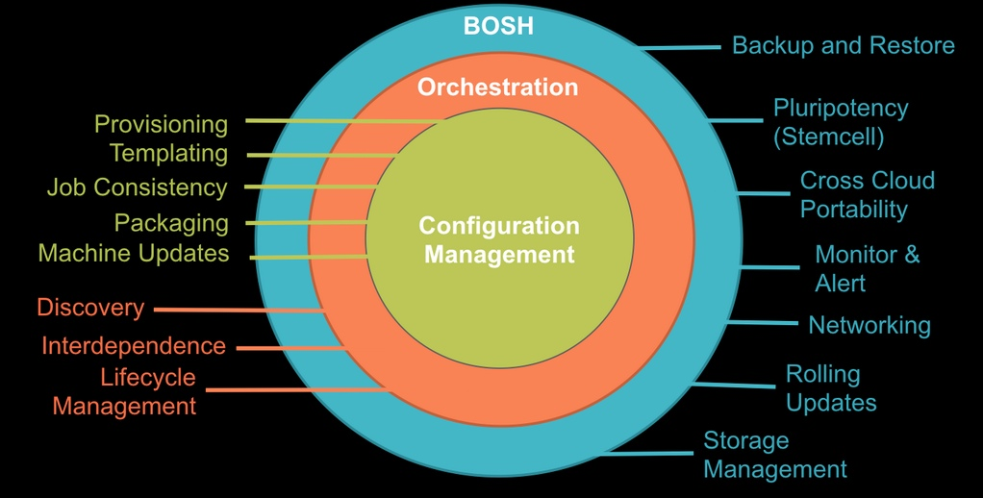
BOSH

Slide 29
Why BOSH
Provision services, not machines
Enables continuous delivery
Cloud-agnostic view of Platform Ops
Holistic Toolchain for “rule them all"
Eliminate bespoke automation on top of config management

Slide 30


Ops Manager + BOSH
IaaS
DB
BOSH
Deploy my
Services
BOSH Director
Worker VMs
Blobstore
NATS
Messaging
Health Manager
Health
Monitor
Cloud Controller
Target VM

Slide 31

Plan capacity
Setup High Availability
Install the platform
Operator Concerns
Manage users
and quotas
Handle upgrades and updates
Monitor the platform

Slide 32
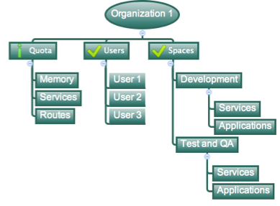
Orgs, Spaces, Users and Quotas

Slide 33
Organizations
Logical division within a Pivotal CF install / Foundation.
Each organization has its own users and assigned quota
User permissions / roles are specified per space within an organization
Sub-divided into Spaces

Slide 34

Quotas and Plans
Different quota limits (e.g. “small”, “enterprise”, “default”, “runaway”) can be assigned per Organization
Quota defines
Total Memory
Total # of Services
Total # of Routes

Slide 35

Spaces
Logical sub-division within an organization
Users authorized at an organization level can have different roles per space
Services and Applications are created / specified per Space
Same Service can have different meanings per space

Slide 36
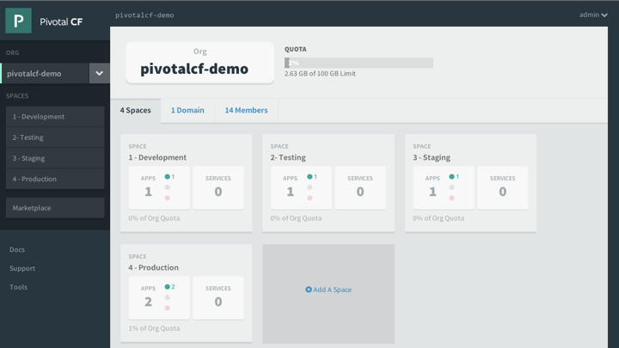

Slide 37
Plan capacity
Setup High Availability
Install the platform
Operator Concerns
Manage users
and quotas
Handle upgrades and updates
Monitor the platform

Slide 38
Platform Monitoring
How do I know when to scale DEAs?
How many requests each Router is servicing?
What is the current load of my Cloud Controllers?

Slide 39
Platform Monitoring
Pivotal Ops Metrics provides a single JMX interface to access metrics for each Pivotal CF component
DEAs
Cloud Controllers
Routers
Health Managers
NATS, UAA, Login Server, …

Slide 40
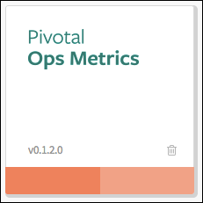
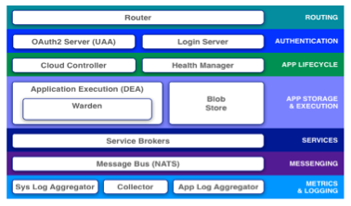
Platform Monitoring
JMX Monitoring Tool
JMX Provider
Collector

Slide 41
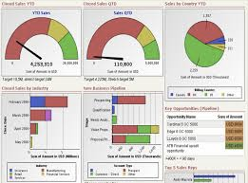
Platform Monitoring
JMX Monitoring Tool
JMX Provider
Collector

Slide 42
Plan capacity
Setup High Availability
Install the platform
Operator Concerns
Manage users
and quotas
Handle upgrades and updates
Monitor the platform

Slide 43
4 Layers of built-in High Availability
Application Instance
Platform Processes
Platform VMs
Availability Zones

Slide 44
4 Layers of built-in High Availability
Application Instance
Platform Processes
Platform VMs
Availability Zones

Slide 45
App Instance HA
Blobstore
Cloud Controller
Actual State
Messaging (NATS)
Health Manager
Router
DEA
DEA
DEA
Cloud Foundry
Runtime

Slide 46
4 Layers of built-in High Availability
Application Instance
Platform Processes
Platform VMs
Availability Zones

Slide 47

Platform Processes HA
BOSH
Pivotal CF
DB
DEA
Agent
Process
BOSH Director
Health Manager
Blobstore
Process
Agent
Messaging
NATS
Agent
Process
Health
Monitor
Cloud Controller
Target VM
Agent
Process

Slide 48

Platform Processes HA
Target VM
Cloud Controller
Agent
Process
Restart

Slide 49
4 Layers of built-in High Availability
Application Instance
Platform Processes
Platform VMs
Availability Zones

Slide 50
Platform VMs HA
BOSH
Pivotal CF
DB
Cloud Controller
Agent
Process
BOSH Director
Re-create VM
Health Manager
Blobstore
Process
Agent
Ressurector
VM is
missing…
Messaging
NATS
Agent
Process
Health
Monitor
Cloud Controller
Agent
Process

Slide 51
4 Layers of built-in High Availability
Application Instance
Platform Processes
Platform VMs
Availability Zones

Slide 52
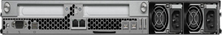
Availability Zones
Availability Zone #1
Availability Zone #2
Blobstore
DEA
Push app
DEA
Cloud Controller
DEA
Router
Messaging (NATS)
DEA
Health Manager
DEA

Slide 53
Plan capacity
Setup High Availability
Install the platform
Operator Concerns
Manage users
and quotas
Handle upgrades and updates
Monitor the platform

Slide 54
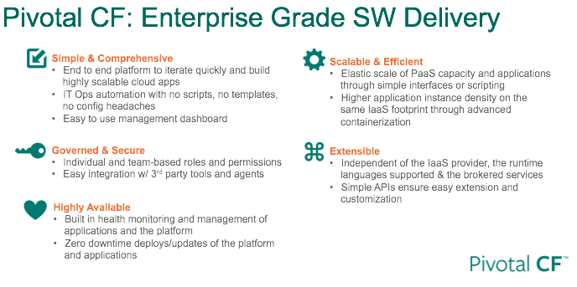

Slide 55
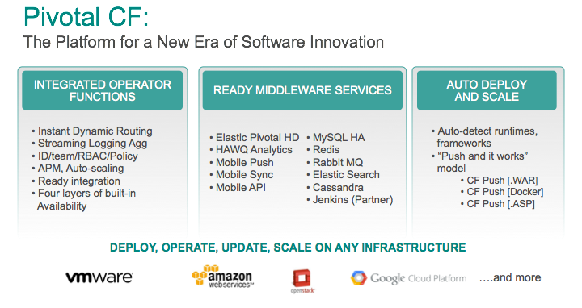

Slide 56
Coming Up
Lunch and Keynote (1:00 - 2:30)
Break (2:30 - 2:45)
Part Three (2:45 - 4:00)
Learn CF Extension Points
DEMO: Customize a Buildpack -OR- Write and Deploy a Service Broker
Break (4:00 - 4:15)
Part Four (4:15 - 5:30)
Learn How CF Enables Continuous Delivery
DEMO: Setup a CD Pipeline with Jenkins, Artifactory, CF Client, and PCF

Slide 57
THANK YOU!
See you after the break!

